Slide 1
Mushroom classification

Slide 2
Objective:
We have to build a solution that should able to predict which mushroom is
poisonous & which is edible.
Benefits:
Prevention is better before cause
Keeps us healthy and safe

Slide 3
Data Sharing Agreement :
This dataset includes descriptions of hypothetical samples corresponding to 23 species of gilled mushrooms in the Agaricus and Lepiota Family Mushroom drawn from The Audubon Society Field Guide to North American Mushrooms (1981). Each species is identified as definitely edible, definitely poisonous, or of unknown edibility and not recommended. This latter class was combined with the poisonous one. The Guide clearly states that there is no simple rule for determining the edibility of a mushroom; no rule like "leaflets three, let it be'' for Poisonous Oak and Ivy.

Slide 4
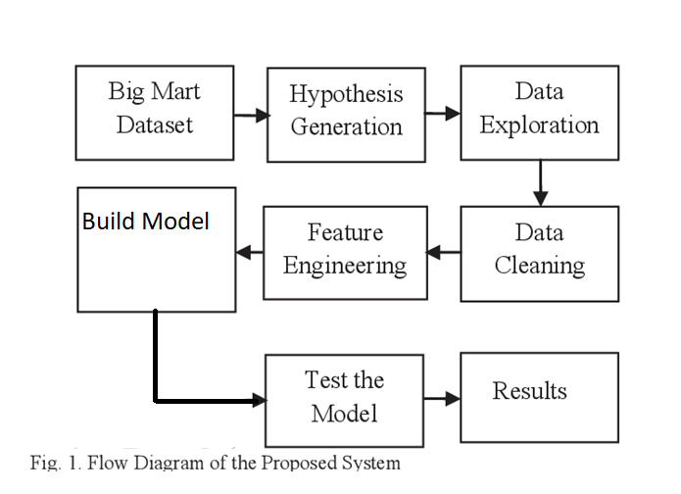
Architecture

Slide 5
Model Training:
The Dataset is in csv format for model training
Performing EDA to get insight of data like identifying distribution , outliers ,trend
among data etc.
Check for null values in the columns. If present impute the null values.
Encode the categorical values with numeric values.
Partioning of train data in train data and test data
Model training and Evaluation
Prediction on Test data

Slide 6
Model Selection –
SGD Classifier builds an additive model in a forward stage-wise fashion; it allows for the optimization of arbitrary differentiable loss functions.

Slide 7
Prediction:
The test data was shared with train data and we perform the same operations on it.
The data was in csv format for prediction.
We perform data pre-processing techniques on it.
SGD Classifier model created during training is loaded and classification of data is done

Slide 8
Q & A:
Q1) What’s the source of data?
The data for training is provided by the client in csv format.
Q 2) What was the type of data?
The data was the combination of numerical and Categorical values.
Q 3) What’s the complete flow you followed in this Project?
Refer slide 5th for better Understanding
.

Slide 9
Q 4) What techniques were you using for data pre-processing?
Removing unwanted attributes
Visualizing relation of independent variables with each other and output variables
Cleaning data and imputing if null values are present.
Converting categorical data into numeric values.

Slide 10
Q 7) How training was done or what models were used?
We perform Partioning on Train data.
The training and validation data were divided.
Algorithms like Gradient Boosting Regressor were used based on the R2 Score, rmse, mae model was used and we saved that model .
Q 8) How Prediction was done?
The testing files are shared by the client .We Perform the same life cycle. Model is loaded and perform prediction. In the end we get the accumulated data of predictions.

Slide 11
Q 9) What are the different stages of deployment?
We do deploying on Heroku platform.
Development.
Review.
Staging.
Production.

